Slide 1
Eastside Type N Characterization Project Forest Hydrology Study
Site Validation Results for Field Effort 2010

Slide 2
SAGE Participants
Jim Mathews, Yakima Nation
Tim McBride, Hancock Forest Management
Lynda Hofmann, WDFW
Chad Macrae, Spokane Tribe of Indians
Todd Baldwin, Kalispel Tribe of Indians

Slide 3
Primary Objectives of Study
1. Determine the spatial and temporal characteristics of surface water discharge in Type N streams across eastern Washington FFR lands
2. Investigate process relationships between stream hydrology, landforms and management activity.
3. Develop criteria for characterizing and mapping streams with similar
characteristics across the FFR landscape
4. Establish a pool of study sites for Extensive and Effectiveness Monitoring.

Slide 4
Objectives of Site Validation
Validate a minimum of 100 sub-basins containing a regulated Type N Stream
Collected data on sub-basins that were validated and rejected

Slide 5
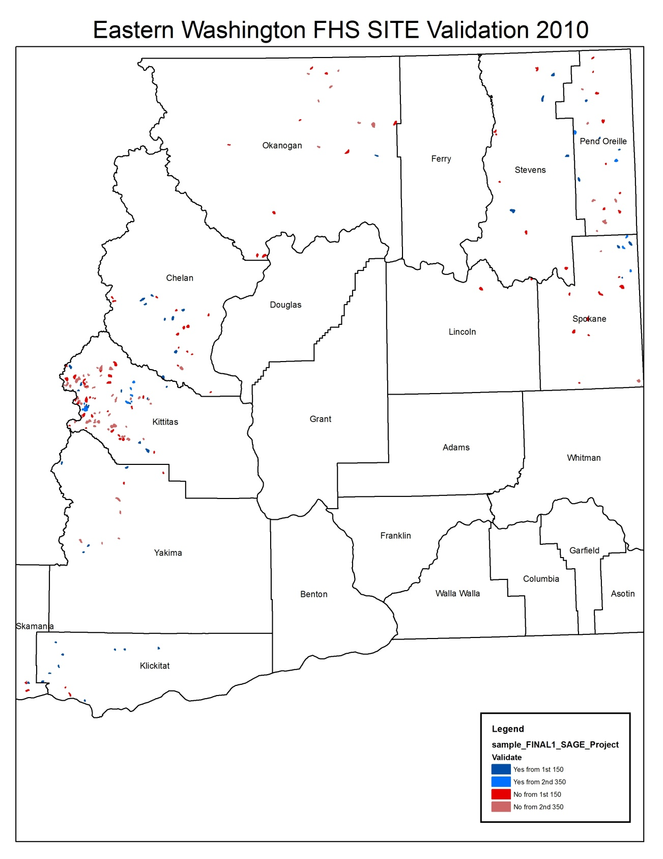

Slide 6
Validated/Rejection Table For 150 Sites
 |  | 1ST 150 FHS SITES |  |  |  | # Sites REJECTED for Each Criteria
 | # OF | # OF | # OF | # OF | 1 | 2 | 3 | 4 | 5 | 6
 | SITES | SITES | SITES | SITES | <25% Forested | <25% FFR | No Access | >3-SFLO's | No Type N | No Permission
 | Selected
County | by SAMPLE | Reviewed | Validated | Rejected | 22% | 23% | 18% | 20% | 39% | 27%
Asotin | 1 | 0 | 0 | 0 | 0 | 0 | 0 | 0 | 0 | 0
Chelan | 23 | 21 | 8 | 13 | 3 | 1 | 0 | 0 | 8 | 5
Columbia | 1 | 0 | 0 | 0 | 0 | 0 | 0 | 0 | 0 | 0
Ferry | 1 | 0 | 0 | 0 | 0 | 0 | 0 | 0 | 0 | 0
Kittitas | 44 | 44 | 13 | 31 | 3 | 17 | 1 | 6 | 2 | 3
Klickitat | 12 | 11 | 9 | 2 | 1 | 0 | 1 | 0 | 0 | 0
Lincoln | 6 | 6 | 0 | 6 | 2 | 0 | 1 | 0 | 2 | 6
Okanogan | 10 | 10 | 0 | 10 | 5 | 1 | 5 | 3 | 4 | 6
Pend Oreille | 12 | 12 | 4 | 8 | 1 | 1 | 2 | 3 | 5 | 3
Skamania | 3 | 3 | 1 | 2 | 0 | 1 | 0 | 1 | 0 | 0
Spokane | 11 | 11 | 3 | 8 | 0 | 0 | 0 | 3 | 5 | 0
Stevens | 19 | 19 | 4 | 15 | 4 | 1 | 6 | 3 | 11 | 3
Walla Walla | 1 | 0 | 0 | 0 | 0 | 0 | 0 | 0 | 0 | 0
Yakima | 6 | 6 | 4 | 2 | 2 | 0 | 1 | 0 | 1 | 0
Total #: | 150 | 143 | 46 | 97 | 21 | 22 | 17 | 19 | 38 | 26

Slide 16
What Did We Learn?
Approximately 2/3 rejection rate across counties
Lowest precipitation zones tend to have the highest validation and rejection rates
The absence of a Type N stream made up 40% of rejected sites
2.5% of sub-basins rejected under Criteria #4 contained Type N Streams

Slide 17
Next Steps
Present results to Dan Miller to determine if possible modifications can be made to “SAMPLE” program
Explore the use of DNR’s WTMF’s database to increase the efficiency of site validation
Move forward with field inventory in 2011-2012 on the 62 sites that have been validated.

